Slide 1
Automotive Introduction

Slide 2

Agenda
01
Introductions
02
Early Automobiles
03
Internal Combustion
04
Automotive Innovation
05
Mass Production

Slide 3
Agenda
06
Automotive Advancement
07
Automotive Styling
08
Global Influence
09
Safety Innovations
10
Digital Revolution

Slide 4

01 – Introductions

Slide 5
Richard Hawkins
Senior Trainer, Revature
15 years professional training experience
Joined Revature in 2021
Background in:
- Robotics
- Mechanical Engineering
- Automotive Maintenance, Design, and Fabrication
- Full-stack .NET Software Development
- Cloud Architecture and DevOps

Slide 6
02 – Early Automobiles

Slide 7
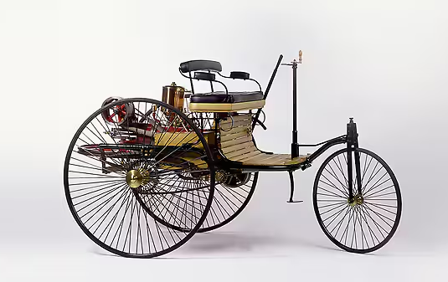
The Benz Patent Motor Car, model no. 1
Notes:
Benz Patent Motor Car
On January 29, 1886, Carl Benz applied for a patent for his “vehicle powered by a gas engine.” The patent – number 37435 – may be regarded as the birth certificate of the automobile. In July 1886 the newspapers reported on the first public outing of the three-wheeled Benz Patent Motor Car, model no. 1.
The major features of the two-seater vehicle, which was completed in 1885, were the compact high-speed single-cylinder four-stroke engine installed horizontally at the rear, the tubular steel frame, the differential and three wire-spoked wheels. The engine output was 0.75 hp (0.55 kW). Details included an automatic intake slide, a controlled exhaust valve, high-voltage electrical vibrator ignition with spark plug, and water/thermo siphon evaporation cooling.

Slide 8
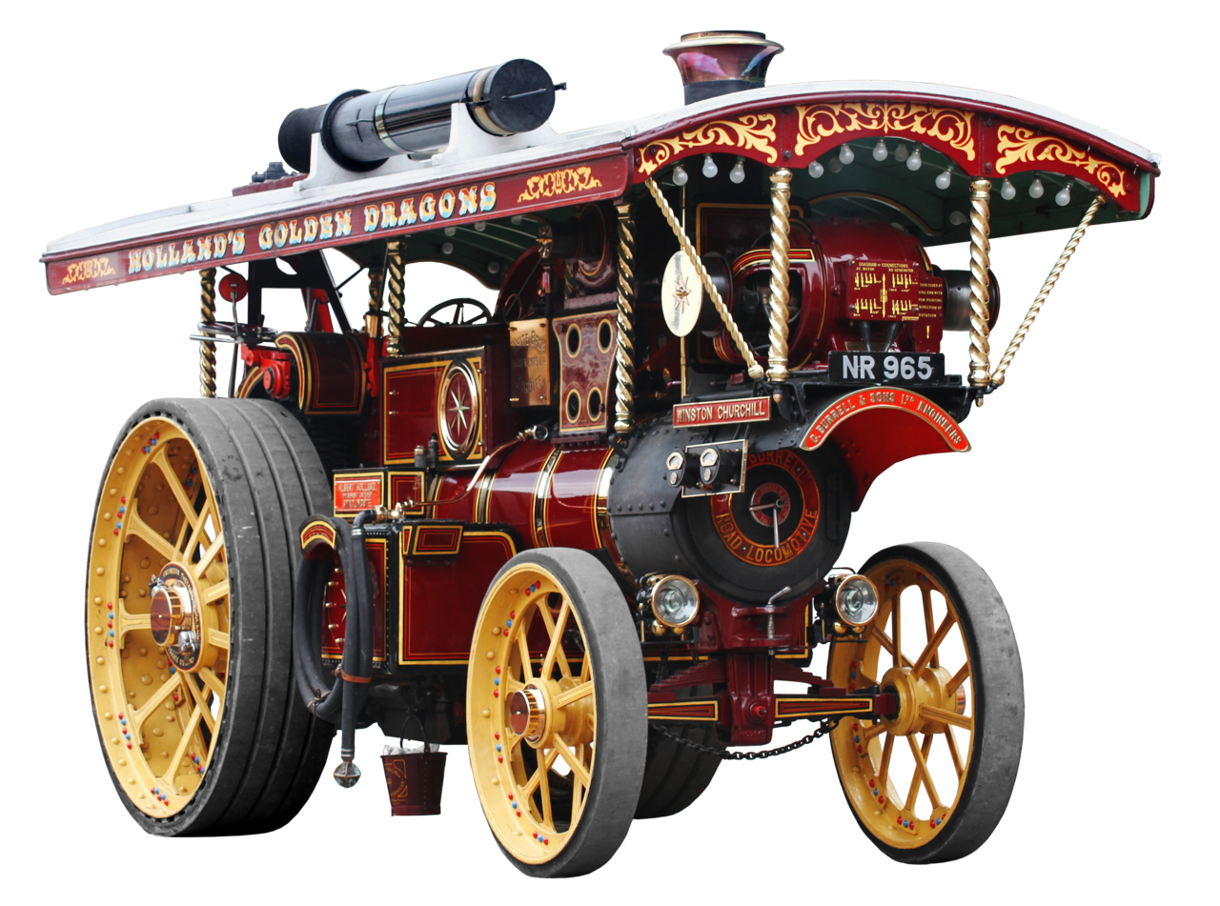
Powering A Vehicle:
Steam, Clockwork,
Electric
Notes:
- Discuss the bulkiness and cumbersome designs of early steam carriages, making them impractical for everyday use.
- Highlight the slow speeds and limited range due to the time required to heat up the boiler and inefficiency of steam engines.
- Mention the difficulty in operating and maintaining these vehicles, requiring skilled personnel to manage the boiler and fire.
- Briefly discuss the safety hazards associated with steam boilers, like explosions due to pressure buildup.
Clockwork-Powered Vehicles:
- Briefly mention the concept of clockwork-powered vehicles, where a spring mechanism would unwind, providing power to the wheels.
- Highlight their limitations in terms of power, range, and practicality. (Optional: You can mention specific inventors who experimented with clockwork vehicles, like Leonardo da Vinci).
Electric Vehicles:
- Discuss the early exploration of electric vehicles in the 19th century.
- Mention inventors like Robert Davidson who built an electric locomotive in 1842.
- Briefly explain the challenges faced by early electric vehicles, such as limited battery range and power storage technology.

Slide 9
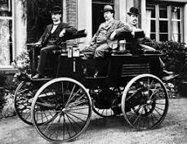
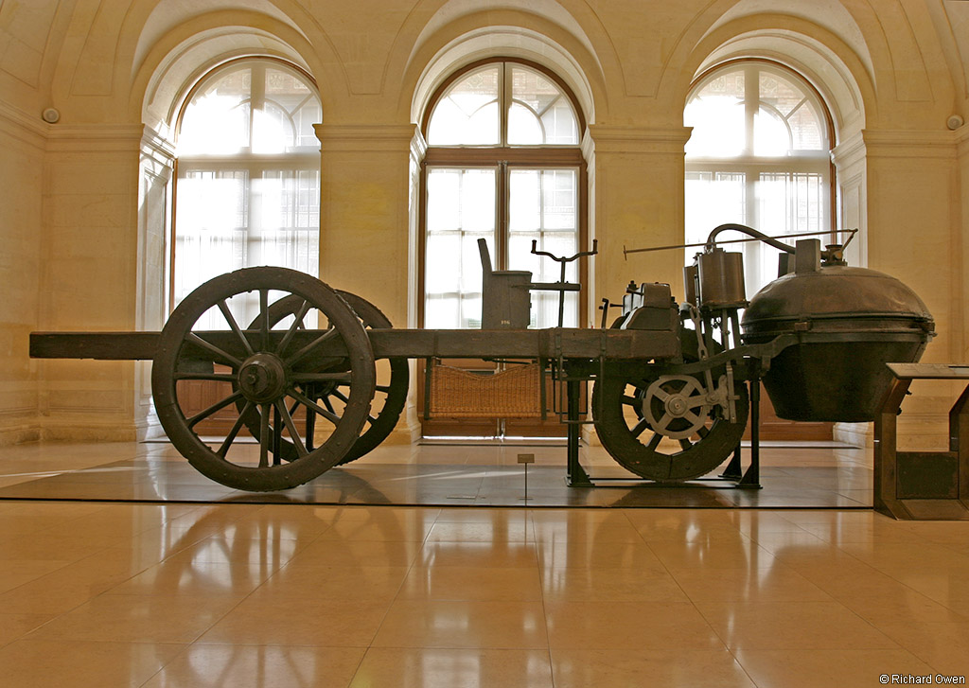
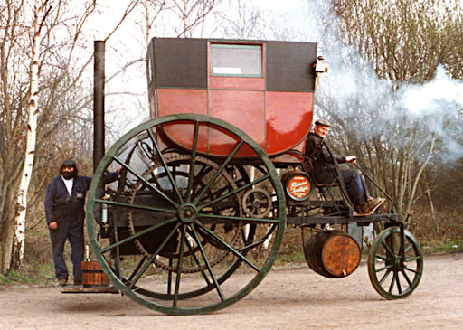
Notable Mentions
Notes:
French Fardier Steam Tractor (1771):
- Briefly mention Nicolas-Joseph Cugnot's steam tractor, considered one of the earliest self-propelled vehicles.
- Highlight its significance as a pioneering effort in using steam power for land vehicles.
Manningham's Steam Carriage (1813):
- You can mention engineer Richard Trevithick's steam carriage built in partnership with Francis Deakin and William Manningham.
- Briefly discuss its features, like a high-pressure steam engine and a wrought-iron boiler.
Flocken Elektrowagen(1888)
German Andraes Flocken
"first" electric car

Slide 10
03 – Internal Combustion

Slide 11
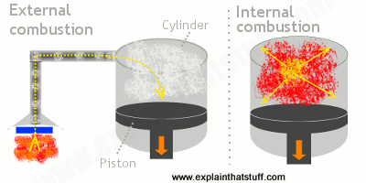
Internal Vs. External
Heat Engine – Convert chemical potential energy to kinetic energy by burning a fuel.
Cylinder – The fixed component which holds and directs the pressure of the engine.
Piston – The moving component which is acted on by the pressure within a cylinder.
External Combustion – The combustion of fuel occurs outside of the cylinder.
Internal Combustion – The combustion of fuel occurs inside of the cylinder.
Notes:
Steam engine – coal fired
Coal production generates (natural) Gas - "gas" engine
Petroleum based – oil engine: no spark, combustion "bulb"
Gasoline – sparked due to higher ignition point
Inefficient engines
Steam – 6%
Gas – 17%
Oil – 10%
Gasoline – 12%
Rudolph Diesel - "Diesel" engine – 27%

Slide 12
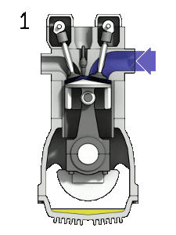
4 – Stroke Engines
4 – Stokes per cycle:
Intake – air and fuel are injected into the cylinder.
Compression – air/fuel mix is compressed.
Combustion – air/fuel mix is ignited.
Exhaust – exhaust gasses are removed from the cylinder
Notes:
4-Stroke Cycle Engine:
- Intake Stroke: The piston moves down, creating a vacuum in the cylinder. A valve opens, allowing a fresh air-fuel mixture to enter the cylinder.
- Compression Stroke: The piston moves back up, compressing the air-fuel mixture. Both intake and exhaust valves are closed during this stroke.
- Combustion Stroke: The spark plug ignites the compressed air-fuel mixture, creating a small explosion that pushes the piston down, generating power.
- Exhaust Stroke: The piston moves up again, forcing the burned exhaust gases out of the cylinder through an open exhaust valve. The intake valve remains closed.
Highlight Nikolaus Otto's development of the four-stroke internal combustion engine.
- Otto's most significant contribution was the development of the four-stroke internal combustion engine in 1876. This engine, often referred to as the "Otto cycle" engine after him, offered significant improvements over Lenoir's design:
- Increased Efficiency: The four-stroke cycle (intake, compression, combustion, exhaust) allowed for more efficient use of fuel, leading to greater power output.
- Greater Control: The separate compression stroke allowed for better control over the fuel-air mixture, resulting in smoother operation.
Operate at higher-than atmospheric pressure (especially for spark-less combustion)
Mechanical energy harnessed. Late 1800's electrical generation boom.
4-stroke generates 1 powered stroke every 2 revolutions.

Slide 13
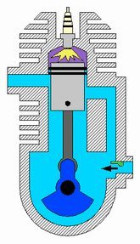
2 – Stroke
2 – Strokes per cycle:
Downstroke - Intake and Compression are performed.
Upstroke - Combustion and Exhaust are performed.
Notes:
2-stroke produces 1 power stroke per revolution.
2x power per cylinder.
2-Stroke Cycle Engine:
- Downward Stroke (Combined Intake and Compression):
- The piston moves down, creating a vacuum.
- A fresh air-fuel mixture is drawn into the crankcase (the area below the piston) through an intake port.
- At the same time, the piston uncovers another port that allows previously compressed air-fuel mixture from the crankcase to flow into the cylinder (compression).
- Upward Stroke (Combined Combustion and Exhaust):
- The piston moves up, closing the intake and transfer ports.
- The compressed air-fuel mixture ignites, creating power (combustion).
- As the piston continues to move up, it uncovers an exhaust port, allowing burned gases to escape.
- At the same time, the crankcase is compressed, preparing the next air-fuel mixture for transfer to the cylinder.
Operate at atmospheric pressure, not much above or below.
- Briefly mention Etienne Lenoir's creation of an early internal combustion engine.
- Lenoir Cycle Engine (1859): Lenoir's most significant contribution was the invention of a two-stroke internal combustion engine in 1859. This engine differed from the later four-stroke engines by having only a power stroke and an exhaust stroke in each cycle.

Slide 14
04 – Automotive Innovation

Slide 15
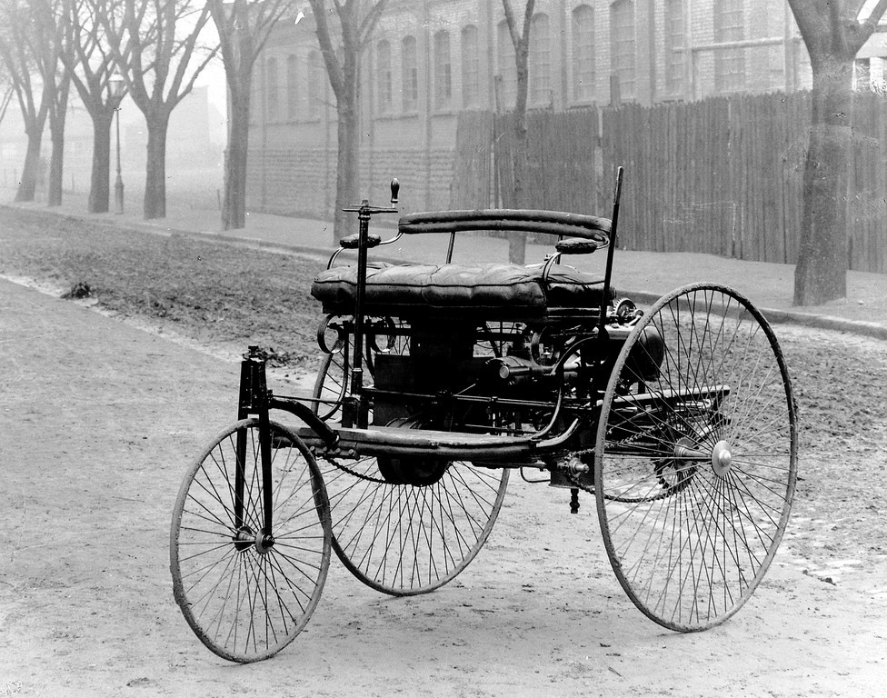
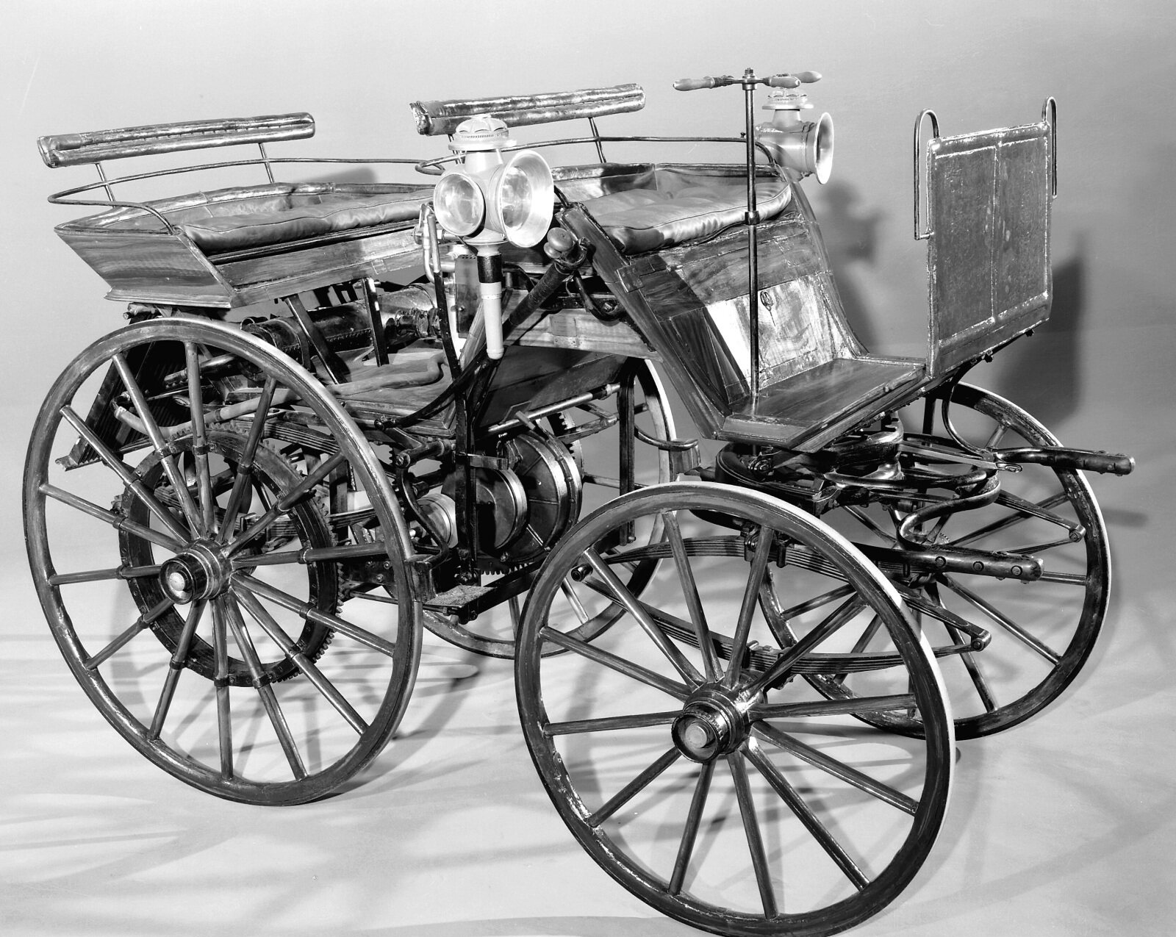
Automotive Innovation
Benz Patent Motorwagen - 1885
Daimler Motorwagen - 1886
Notes:
Introduce Karl Benz's Patent Motorwagen (1885):
- Discuss its three-wheeled design and gasoline engine.
- Mention its significance as the first practical automobile.
Introduce Gottlieb Daimler's Motorwagen (1886):
- Highlight its four-wheeled design and improvements over Benz's model.
- Briefly mention its impact on the development of modern cars.
-14.29 mph
-"stagecoach", not patented
Within a few years, hundreds of producers across the Western world were using many technologies. Steam, electricity, and gasoline-powered automobiles competed for decades, with gasoline internal combustion engines achieving dominance by the 1910s. Dual- and even quad-engine cars were designed, and engine displacement ranged to more than 12 L (3.2 US gal). Many modern advances, including gas/electric hybrids, multi-valve engines, overhead camshafts, and four-wheel drive, were attempted and discarded at this time.
Innovation was not limited to the vehicles themselves. Increasing numbers of cars propelled the growth of the petroleum industry,[47]: 60–61 as well as the development of technology to produce gasoline (replacing kerosene and coal oil) and of improvements in heat-tolerant mineral oil lubricants (replacing vegetable and animal oils).[47]: 60

Slide 16
05 – Mass Production

Slide 17
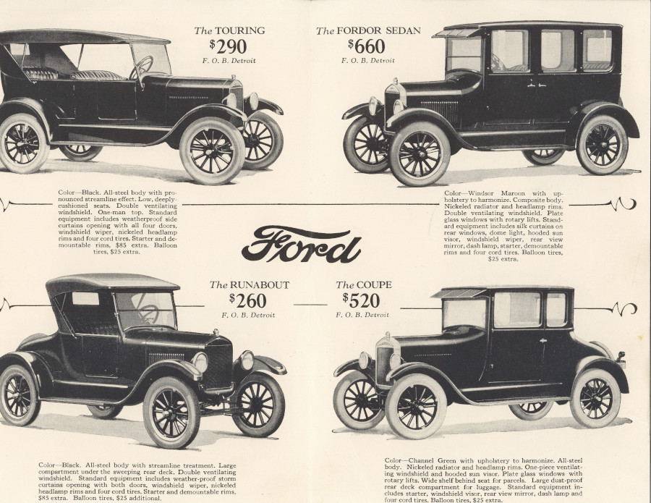
Ford Model T
Start production - 1/10/1908
Initial cost - $825
Cost in 1924 - $290
Notes:
Highlight the Impact of the Model T on Society and Transportation Infrastructure:
- Discuss how the Model T made cars affordable for the average person.
- Mention the rise of suburbs and increased dependence on automobiles.
- Briefly touch upon the development of road infrastructure to accommodate cars.

Slide 18
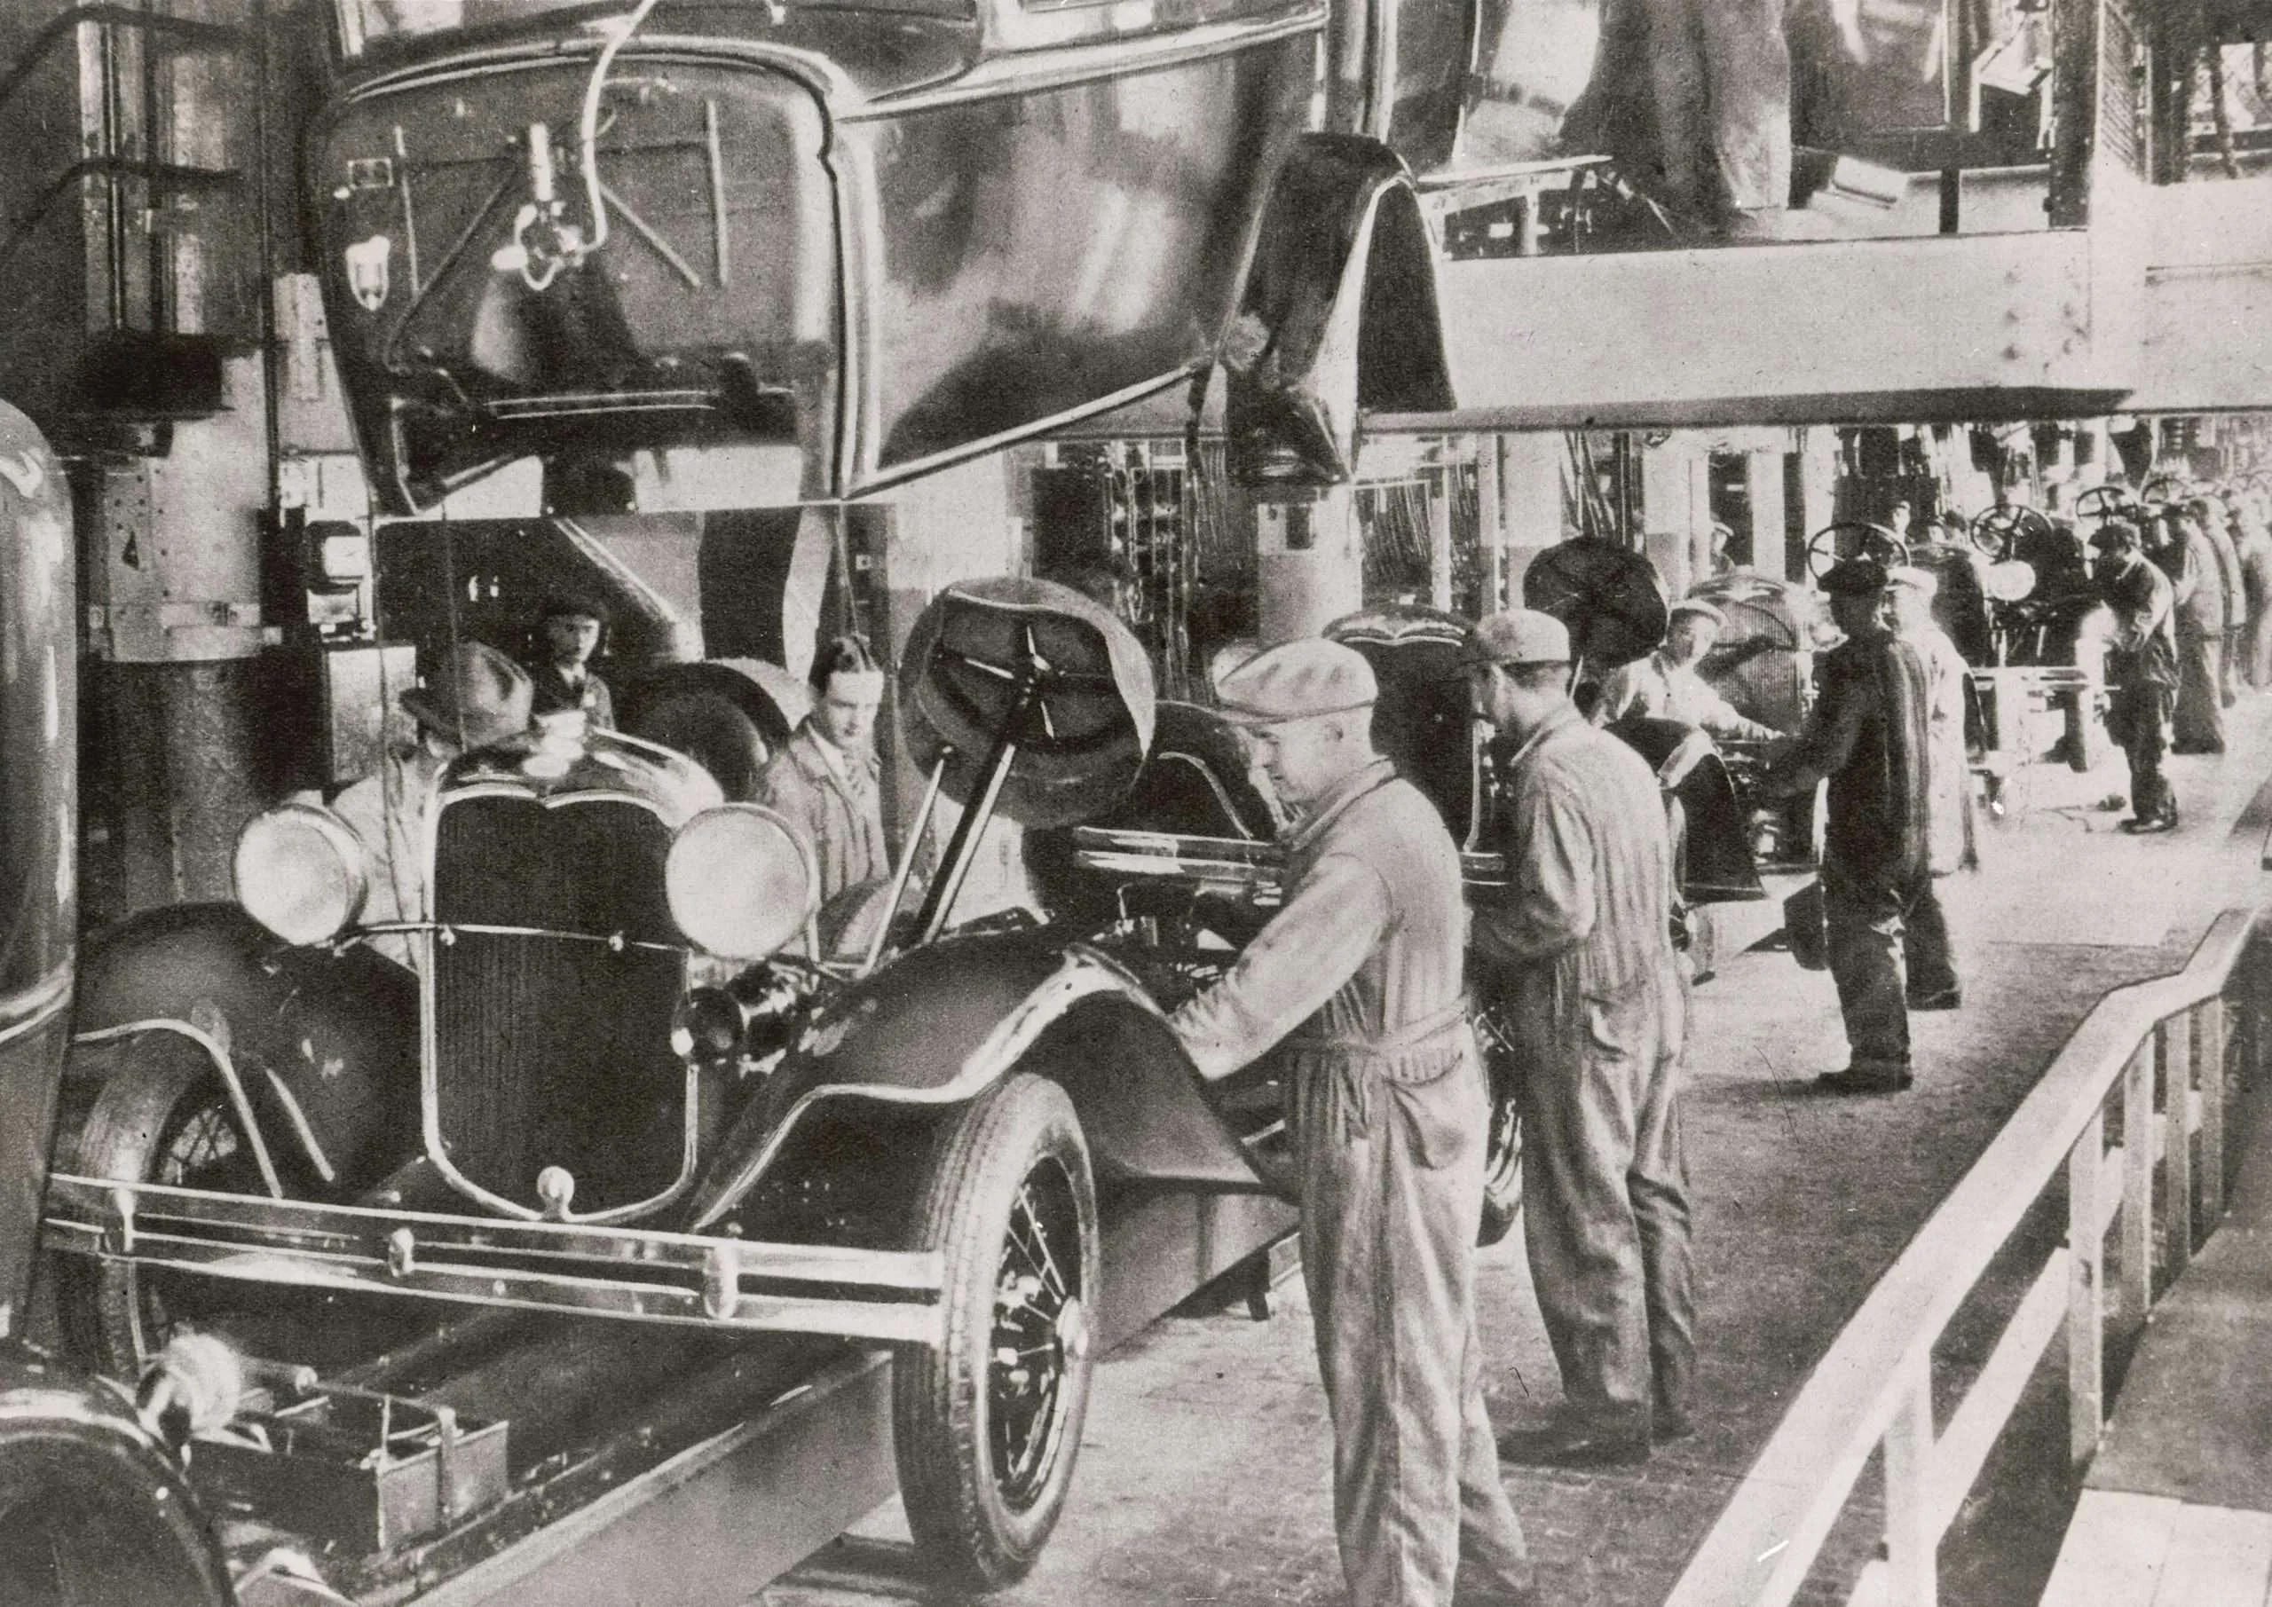
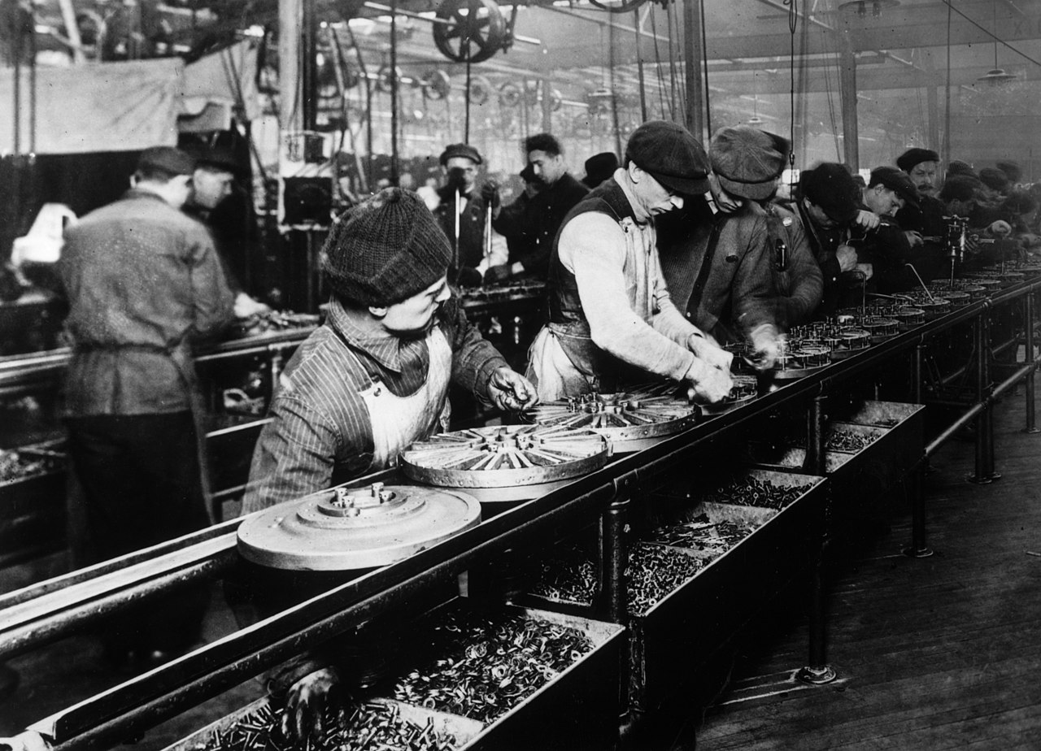
Production Line / Assembly Line
Notes:
Discuss the Concept of Assembly Line Production and its Benefits:
- Explain how assembly lines increase efficiency and reduce costs.
- Mention the division of labor and specialized tasks.
-production time: 90min

Slide 19
06 – Automotive Advancement

Slide 20



Industry Competition and Advancement
Notes:
Introduce Other Early Car Manufacturers Like General Motors and Chrysler:
- Discuss the competition between Ford and other automakers.
- Briefly mention the impact of this competition on innovation and design.

Slide 21
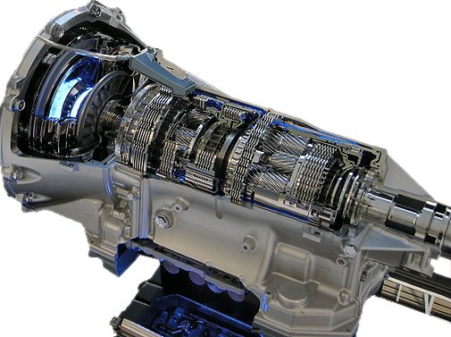
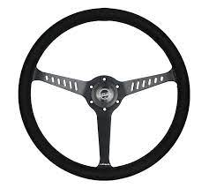
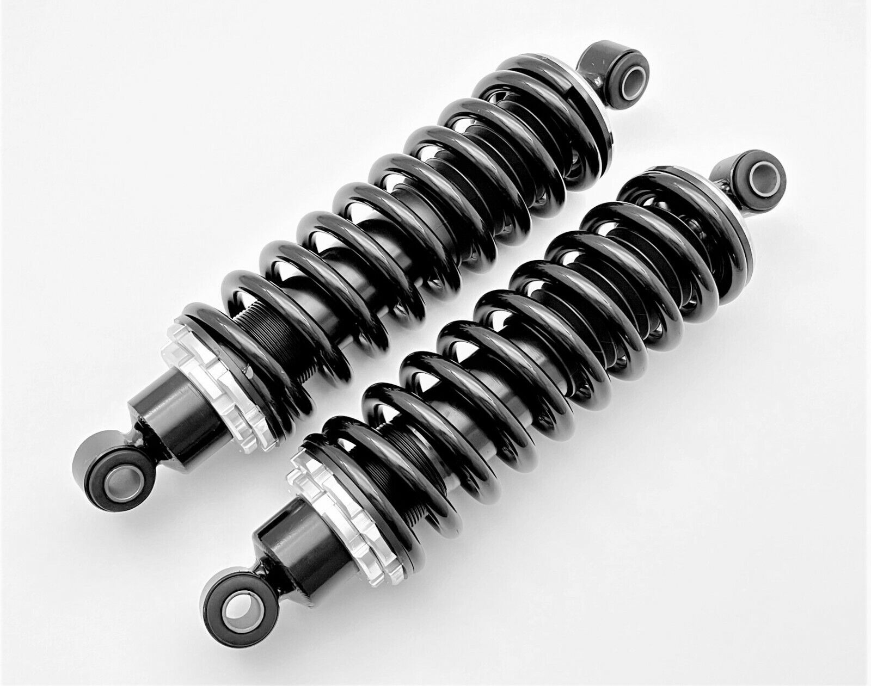
Industry Competition and Advancement
Notes:
Discuss the Development of Key Components Like Steering Wheels, Transmissions, and Suspension Systems:
- Explain the evolution of steering wheels from tillers to more user-friendly designs.
- Discuss the development of different transmission types (manual, automatic).
- Briefly mention the importance of suspension systems for ride comfort and handling.

Slide 22
07 – Automotive Styling

Slide 23
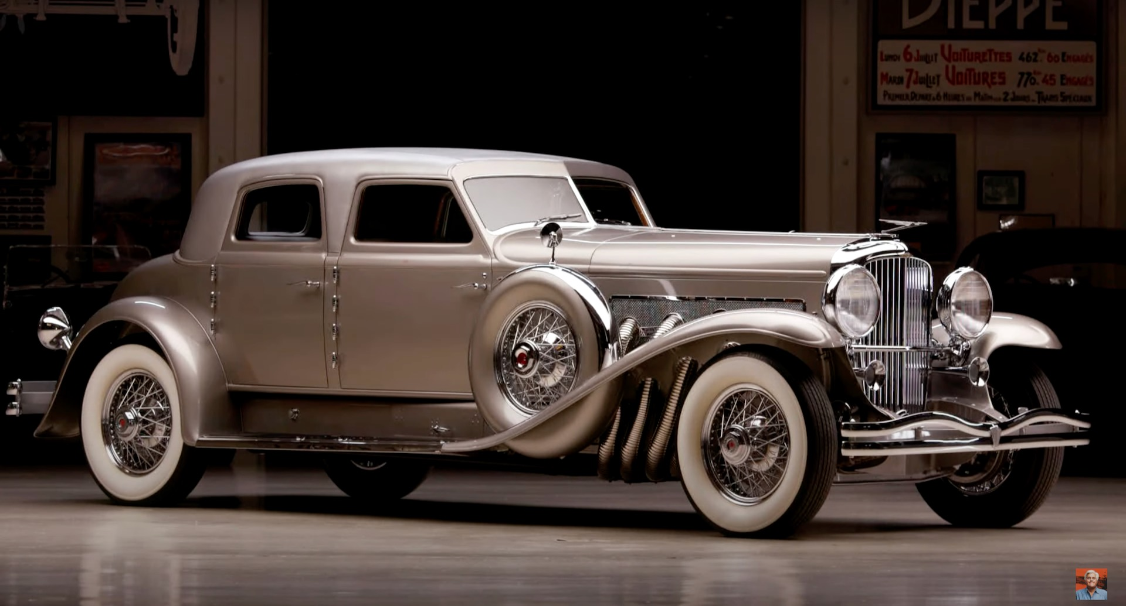
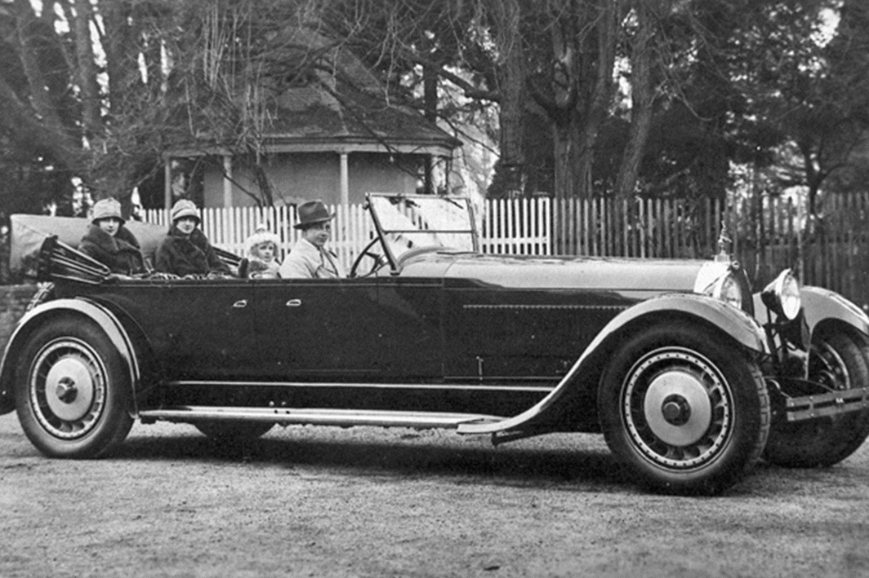
Functional Vs. Aesthetic Design
Notes:
The Emergence of Car Design and the Concept of Planned Obsolescence:
- Discuss the shift from functional designs to aesthetics and style.
- Briefly introduce the concept of planned obsolescence and its impact on consumer behavior. (Optional: You can mention specific car models that exemplified these trends).
Mention Iconic Car Models Like the Duesenberg and Bugatti:
- Briefly discuss the design features and luxury elements of these cars.
- You can mention other notable car models from this era if time permits.

Slide 24
08 – Global Influence

Slide 25
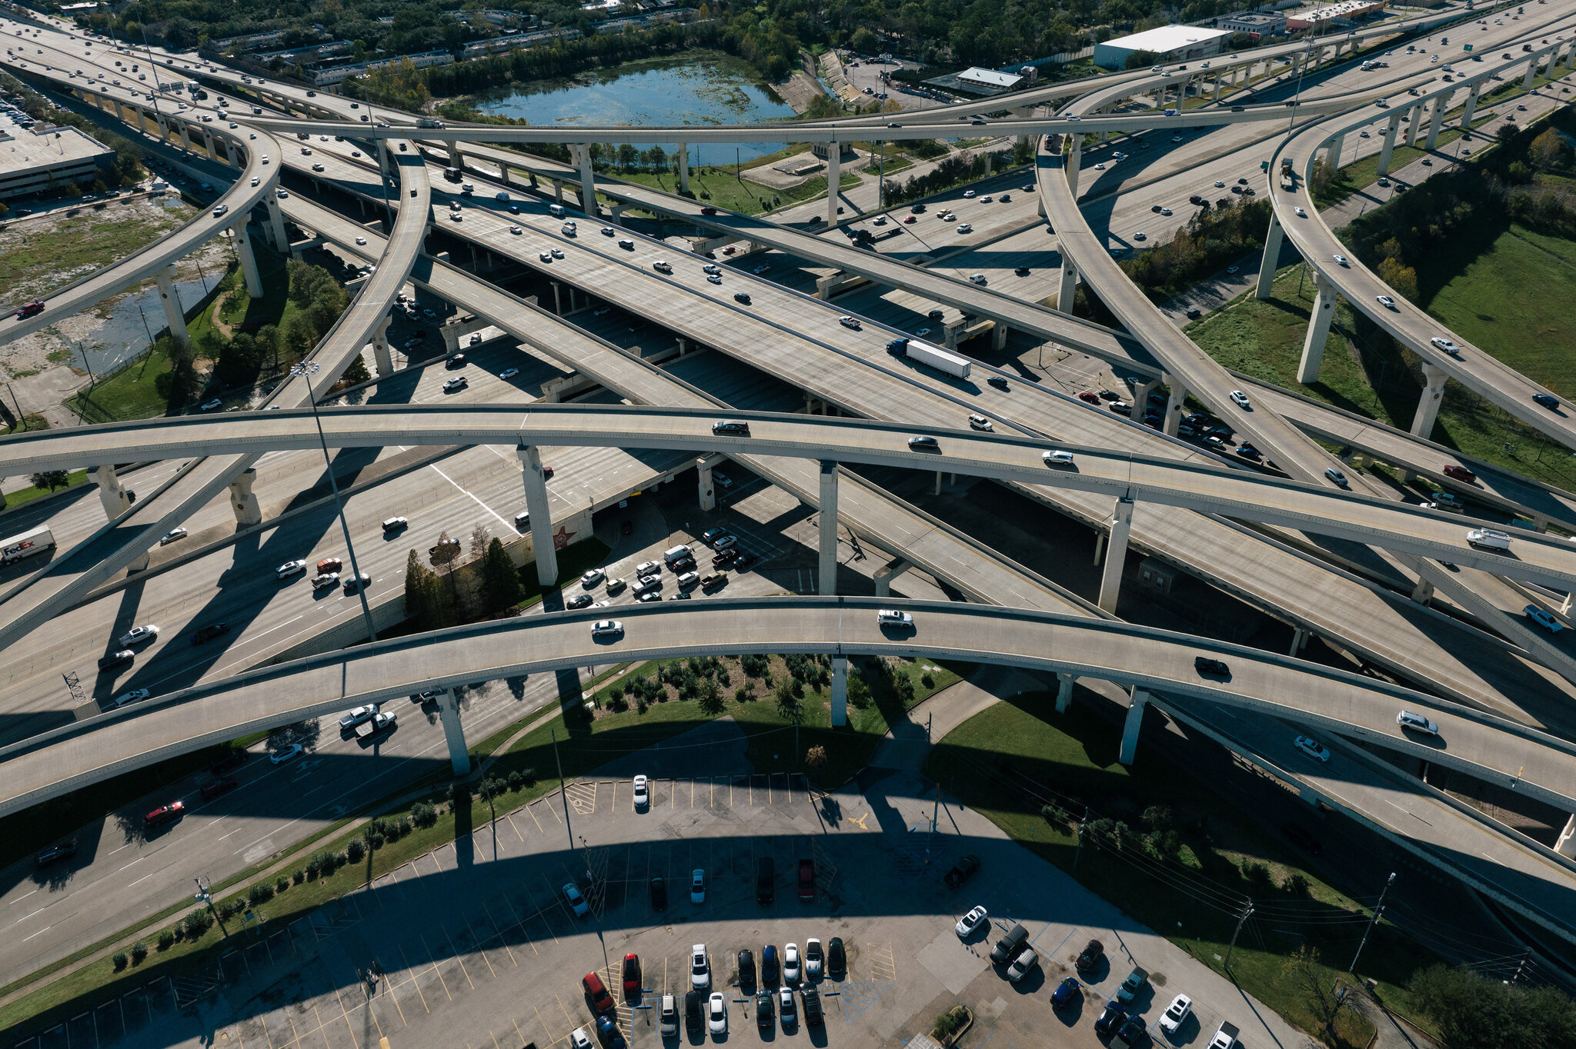
Industry, Manufacturing, and Infrastructure
Competition drives innovation.
World War II leads to global industrial and manufacturing boom.
Infrastructure development leads to greater vehicle capability.
Notes:
Discuss the Impact of the Economic Downturn and the War on Automotive Production:
- How the Depression decreased consumer demand for cars.
- How car manufacturers shifted focus to wartime production (military vehicles).
Briefly Mention the Development of Military Vehicles Like Jeeps and Tanks:
- Highlight the importance of these vehicles in warfare.
- You can discuss specific features or functionalities of these vehicles (optional).

Slide 26
Early Japanese Automakers
Mazda launched the Mazda-Go Auto-rickshaw in 1931.
Toyota launched the G1 in August 1935.
Honda launched the T360 in August 1963.
Notes:
The Emergence of Japanese Automakers Like Toyota and Honda:
- Discuss the focus of Japanese manufacturers on fuel efficiency, reliability, and affordability.
- Briefly mention their impact on the global automotive market.
Highlight their Innovative Manufacturing Techniques:
- You can mention concepts like Just-in-Time (JIT) manufacturing and its efficiency benefits (optional).

Slide 27
09 – Safety Innovation

Slide 28
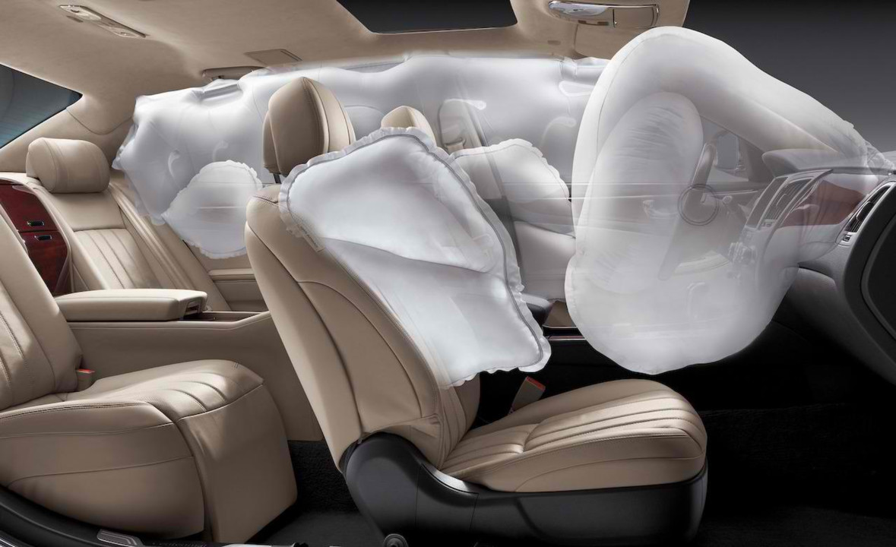
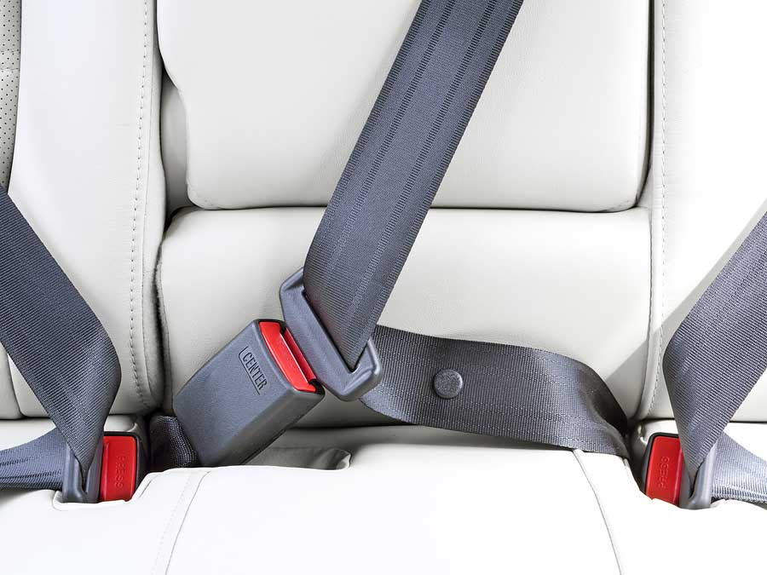
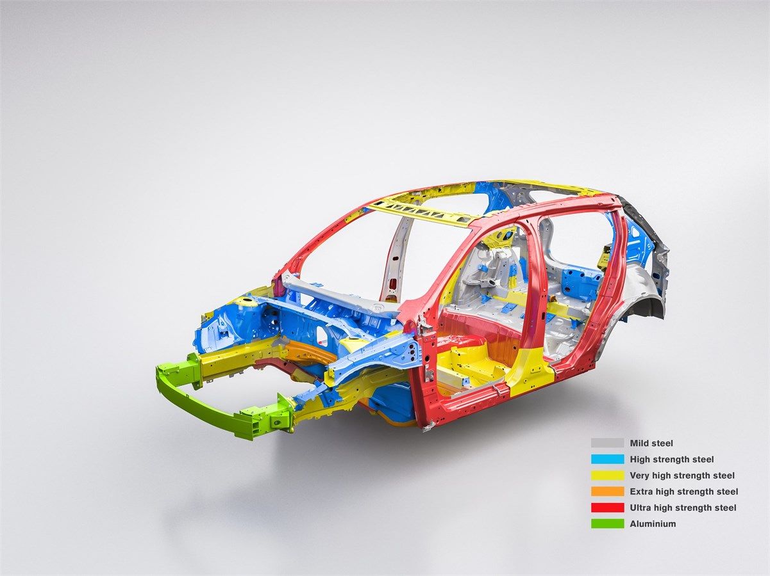
Driving Safety
Notes:
Introduction of Safety Features:
- Discuss the development and implementation of seat belts to restrain passengers.
The first modern three-point seat belt (the so-called CIR-Griswold restraint) commonly used in consumer vehicles was patented in 1955 U.S. patent 2,710,649 by the Americans Roger W. Griswold and Hugh DeHaven. Saab introduced seat belts as standard equipment in 1958.
- Briefly mention the concept of crumple zones and their role in car safety.
In 1959, Mercedes-Benz started to manufacture cars designed to absorb impact energy using the concept. And with the introduction of safety ratings in the late '70s, virtually all manufacturers of passenger cars and light trucks have adopted the design to improve their scores.
- Highlight the invention and impact of airbags on reducing collision fatalities.
The first commercial designs were introduced in passenger automobiles during the 1970s, with limited success and caused some fatalities. Broad commercial adoption of airbags occurred in many markets during the late 1980s and early 1990s. Many modern vehicles now include six or more units.

Slide 29
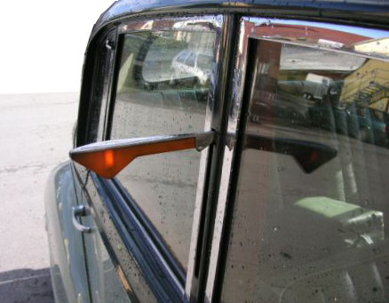
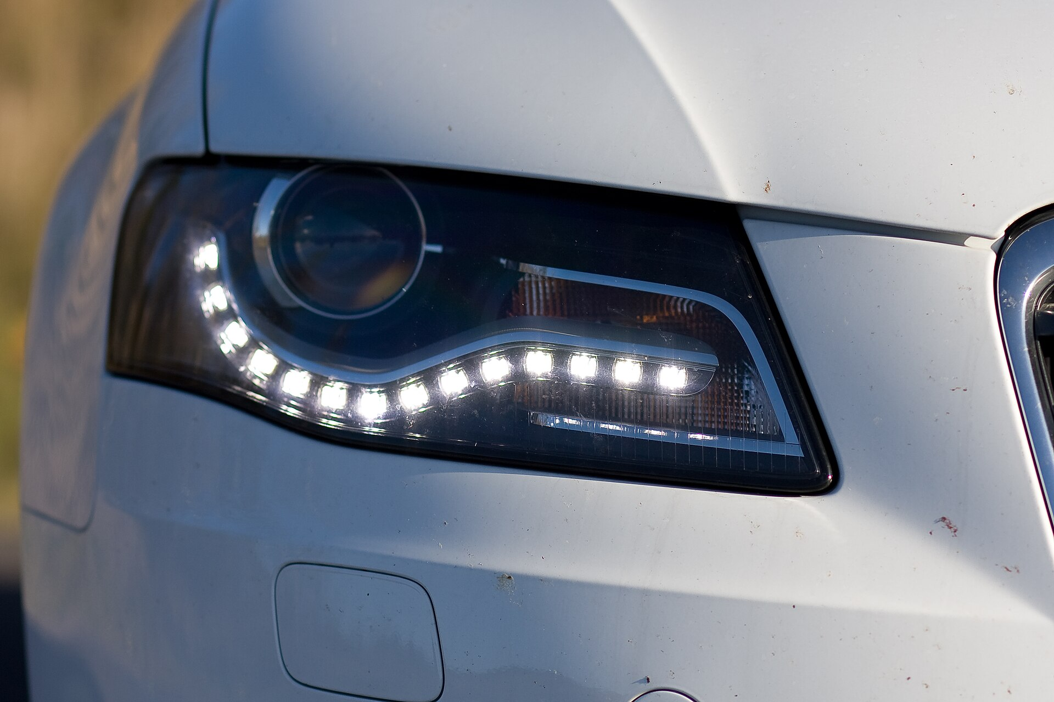
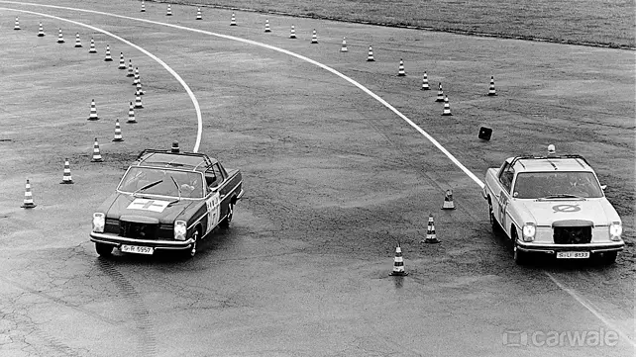
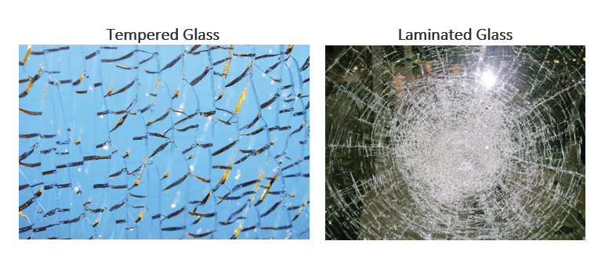
Driving Safety
Notes:
ABS
The modern ABS system was invented in 1971 by Mario Palazzetti (known as 'Mister ABS') in the Fiat Research Center and is now standard in almost every car. The system was called Antiskid and the patent was sold to Bosch who named it ABS.
Windscreen
The car windshield debuted in 1904. Constructed out of plate glass, it could fold horizontally. For the next decade, though, windshields — along with headlights and speedometers — were optional. Oldsmobile made automotive history in 1915 by including windshields as standard features.
Tempered glass - The glass is heated in a furnace to over 1,000 degrees Fahrenheit and then quickly cooled using high-pressure air blasts. This cools the outer layers of the glass much more quickly than the internal layers, so when the inside cools, it pulls away from the outer layers.
Laminated glass is constructed of two plies of glass which are bonded together with interlayers to form a permanent bond. The interlayers work to support and hold the glass to create a strong, uniformed layer even when broken.
Laminated glass first used in 1927
Lighting and Signaling
Trafficators—signalling arms that flipped up, which later were lighted—were introduced in about 1900.[1] Silent film star Florence Lawrence is credited with introducing an innovative version of the signalling arm in 1914, a predecessor to the modern turn signal, and a mechanical brake signal. She did not patent these inventions, however, and received no credit or profit from them.[2][3][4] Tail lights and brake lights were introduced around 1915, and by 1919, low-beam or dipped beam headlights were available. Sealed beam headlights were introduced in 1936 and standardized as the only acceptable type in the US in 1940. Self-cancelling turn signals were developed in 1940. By 1945, headlights and signal lights were integrated into the body styling. Halogen headlights were developed in Europe in 1960. High-intensity discharge (HID) headlights were produced starting in 1991. In 1993, the first LED tail lights were installed on mass-production automobiles, with LED headlights subsequently being introduced in the 2000s as more powerful LEDs became available.[5]

Slide 30
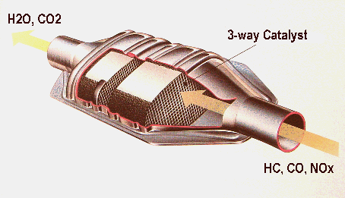
Environmental Safety
1959 – Catalytic Muffler Invented
1970 – Clean Air Act (US)
1975 – First Catalytic Converter
1981 – First Three-Way Catalytic Converter
Notes:
Advancements in Fuel Efficiency and Emission Control Technologies:
- Explain the development of fuel injection systems for better engine performance and efficiency.
- Discuss the introduction of catalytic converters to reduce harmful exhaust emissions.
- Briefly mention government regulations on fuel economy and emission standards.
In the mid-1950s Eugene Houdry, a French mechanical engineer, received a patent for his research to develop catalytic converters for gasoline engines. Houdry's development of the catalytic converter came from his concerns about the toll smokestack and automobile exhaust was having on air pollution.
The three-way catalytic converter currently permits the most efficient, safest and most reliable form of emission control in petrol engines. As the name implies, the three-way catalytic converter converts three pollutants: hydrocarbons (HC), carbon monoxide (CO) and nitrogen oxides (NOx) into less harmful gases.

Slide 31
10 – Digital Revolution

Slide 32
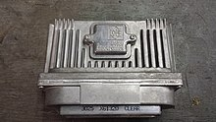
Electronic Control Units/Modules (ECU/ECM)
1930's – Aircraft engine management
1975 – Ford EEC
Notes:
The Introduction of Electronic Engine Management and Onboard Computers:
- Explain how Electronic Control Units (ECUs) manage various engine functions.
- Discuss the role of onboard computers in providing information and entertainment to drivers.
- Briefly mention the development of advanced driver-assistance systems (ADAS).
In the early 1970s, the Japanese electronics industry began producing integrated circuits and microcontrollers used for controlling engines.[6] The Ford EEC (Electronic Engine Control) system, which utilized the Toshiba TLCS-12 microprocessor, went into mass production in 1975.[7]

Slide 33

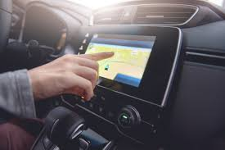
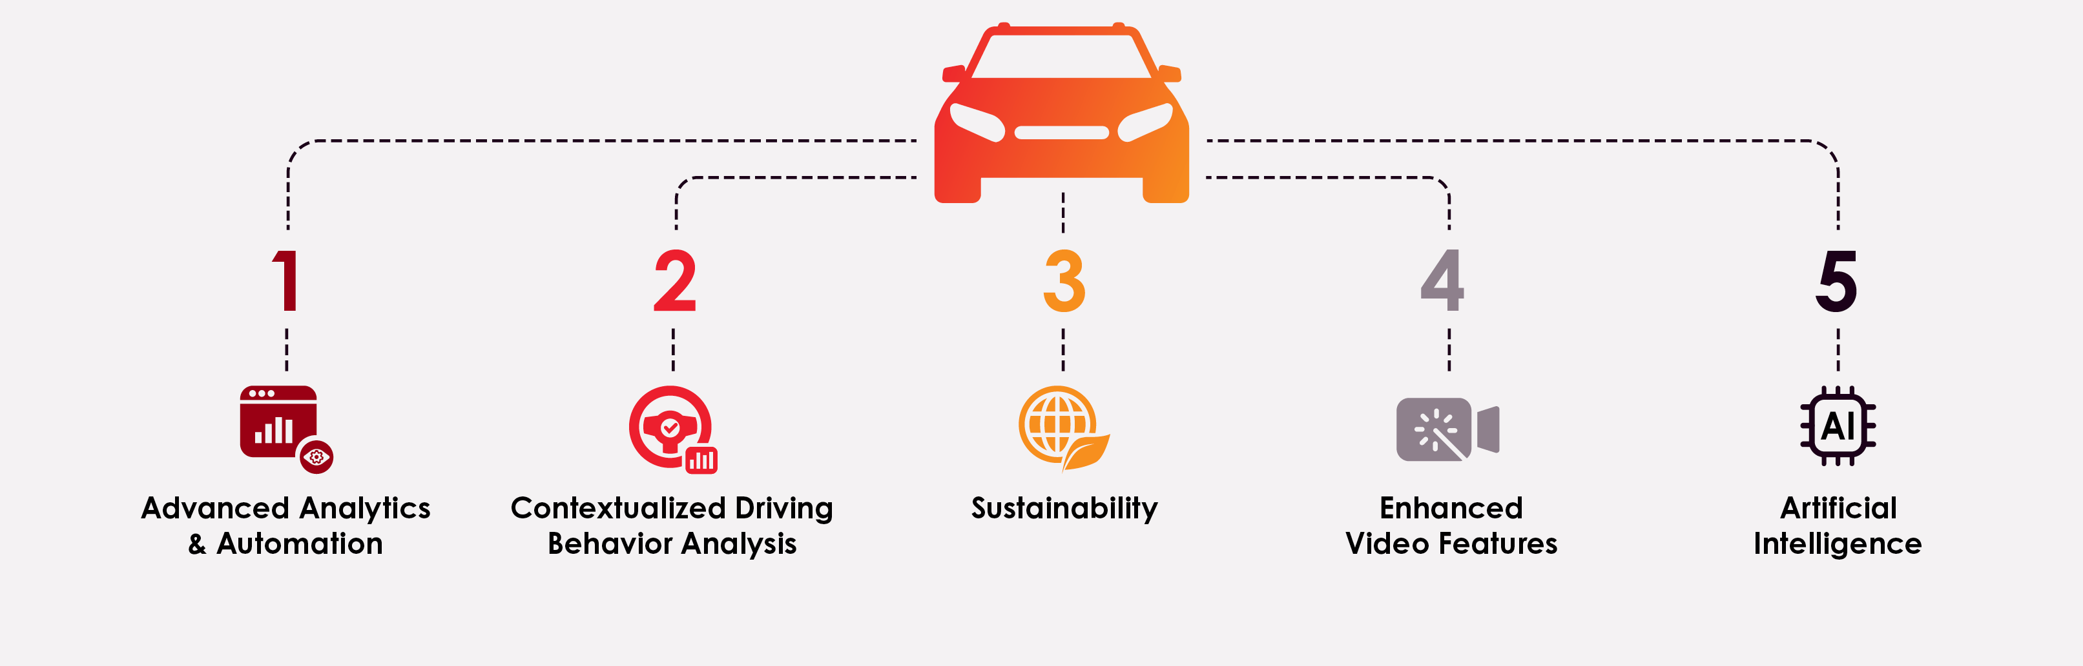
Telematics and Inter-Connection
Notes:
Slide 12: The Future of Automobiles: Challenges and Opportunities
Challenges of Electric Vehicle Adoption and Infrastructure Development:
- Discuss the high upfront cost of electric vehicles compared to gasoline-powered cars.
- Mention the limitations of current electric vehicle charging infrastructure and range anxiety.
The Potential of Self-Driving Cars and the Impact on Society:
- Discuss the potential benefits of self-driving cars in terms of safety and traffic congestion.
1986: Launching the CAN protocol
1987: First CAN controller chips from Intel and Philips Semiconductors
1991: Bosch's CAN specification 2.0 published
GPS/Navigation
1990: Mazda Eunos Cosmo became the first production car with built-in GPS-navigation system[13]
1994: 24th GPS satellite installed in orbit, GPS considered "operational"
Telematics
1997: First internet-based telematics (PHH InterActive) was established
Location, performance, system management, maintenance data

Slide 34
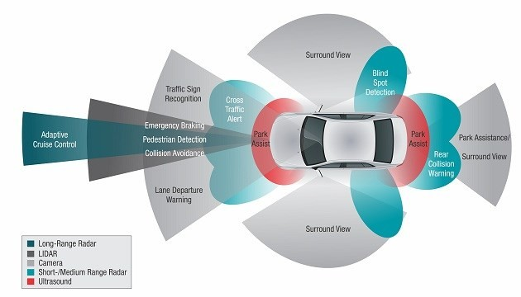
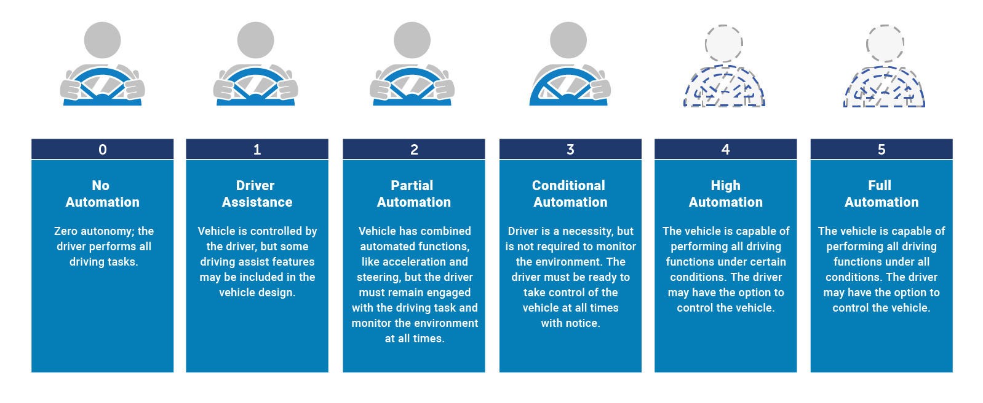
ADAS and Future Development
Notes:
Advanced driver-assistance systems, are technological features that are designed to increase the safety of driving a vehicle.
The Development of Autonomous Vehicles and Alternative Fuel Sources:
- Discuss the concept of self-driving cars and the different levels of autonomy.
Level 0 (No Driving Automation)
Level 1 (Driver Assistance)
Level 2 (Partial Driving Automation)
Level 3 (Conditional Driving Automation)
Level 4 (High Driving Automation)
Level 5 (Full Driving Automation)
- Briefly mention the challenges and advancements in autonomous vehicle technology.
- Introduce alternative fuel sources like electric vehicles, hybrids, and hydrogen fuel cells.
- Briefly discuss the development of electric vehicle charging infrastructure.
Briefly Summarize the Key Advancements in Automotive History:
- Highlight the major milestones from steam-powered vehicles to modern electric cars.
- Briefly mention the evolution of car design, safety features, and technology.
End with a Thought-Provoking Statement About the Future of Transportation:
- Discuss potential future trends like flying cars or personalized mobility solutions.
- Encourage the audience to think about the role of automobiles in society and their impact on the environment.

Slide 35
Thank You!

